Slide 1
Network Fundamentals
Module 6

Slide 2
Objectives
Identify Common Network Devices
Define Protocols
Fundamentals of DNS
Network Configuration Tools

Slide 3
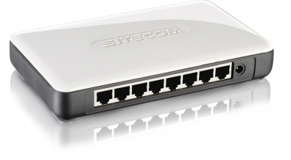
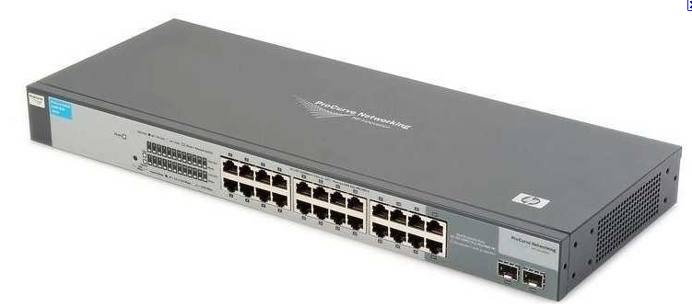
Common Network Devices
Network Interface Card (NIC)
  Allows computer to talk to a network
Hub
  Allows multiple network devices to connect. A signal comes in one port and is transmitted to all other ports.
Switch
  Allows multiple network devices to connect, but does not distribute signals without verifying whether it really needs to propagate to a given port or ports

Slide 4
Common Network Devices
Wireless Access Point (WAP)
  Allows users to connect to a network without ‘wires’
    RF signals are used to communicate instead of physical wires
  Wireless access standards are broadly divided into 802.11a, 802.11b, and 802.11g
Router
  Forwards data packets between networks; used to connect different networks and transfer packets between them
Gateway
  Used to connect two different types of networks
Modem
  Translates digital signals from a computer into analog signals
Notes:
http://www.starlancs.com/EducateMe/educate_network_devices.html

Slide 5

Protocols
Protocols
  A set of rules that governs the communications between computers on a network
  Not hardware (cable, routers, etc.); rather what makes all the hardware function together and allows it communicate
Internet Protocol (IP)
  A set of related network protocols (TCP, UDP, HTTP, FTP, ARP, ICMP) used to move data around the Internet and other networks
Protocols allow the following to occur
  Streaming video or music online (UDP)
  Changes www.google.com to 74.125.45.99
    (DNS)
  Safely perform transactions online (SSL)
  Chat online (IRC)
Notes:
This lesson will provide a very basic introduction to protocols, the OSI and TCP/IP models, and will examine some details on a few common network protocols.
http://fcit.usf.edu/network/chap2/chap2.htm

Slide 6
Protocols
TCP/IP – Transmission Control Protocol/Internet Protocol
  Most commonly used protocol for Internet communication
IP Addressing
  The IP address uniquely identifies computers on a TCP/IP network
  Every “node” (client, server, router) on a network has to have a unique IP address (192.168.1.15 for example)
UDP - User Datagram Protocol
  A connectionless service
  Main alternative to TCP
DNS - Domain Name System
  Translates network address (such as IP addresses) into terms understood by humans (such as Domain Names) and vice-versa

Slide 7

Protocols
DHCP - Dynamic Host Configuration Protocol
  Can automatically assign Internet addresses to computers and users
FTP - File Transfer Protocol
  A protocol that is used to transfer and manipulate files over the network
HTTP - HyperText Transfer Protocol
  An Internet-based protocol for sending and receiving web pages
HTTPS - HyperText Transfer Protocol Secure
  An Internet-based protocol for sending and receiving WebPages securely
IMAP - Internet Message Access Protocol
  A protocol for e-mail messages on the Internet

Slide 8

Protocols
IRC - Internet Relay Chat
  A protocol used for Internet chat and other communications
POP3 - Post Office protocol Version 3
  A protocol used by e-mail clients to retrieve messages from remote servers
SMTP - Simple Mail Transfer Protocol
  A protocol for e-mail messages on the Internet
ARP – Address Resolution Protocol
  Converts an IP address to its corresponding
  physical network address

Slide 9

Protocols
SNMP - Simple Network Management Protocol
  A standard TCP/IP protocol used to monitor and map network availability, performance, and error rates
Telnet
  A remote terminal access protocol
SSH – Secure Shell
  A secure remote terminal access protocol
SSL - Secure Sockets Layer
  A security protocol to enable Web sites to pass sensitive information securely in an encrypted format
LDAP - Lightweight Directory Access Protocol
  A network protocol and a standard architecture for organizing the directory data

Slide 10

TCP
Most communications are handled using TCP
TCP is reliable
  Acknowledgements indicate delivery of data
  Checksums are used to detect corrupted data
  Sequence numbers detect missing, or mis-sequenced data
  Corrupted data is retransmitted after a timeout
  Mis-sequenced data is re-sequenced
  Flow control prevents over-run of receiver
  Uses congestion control to share network capacity among users
  TCP is connection-oriented
Commonly used for
  World Wide Web
  E-mail
  File transfer
Notes:
TCP is the protocol described here for guaranteed transmission (and reception) of information. It is a common protocol used on the Internet.
In order to guarantee the transmission, TCP uses certain techniques to determine that packets have been received and in order. This begins with what is commonly referred to as the 3-way handshake.

Slide 11

UDP
UDP is not reliable
  Not guaranteed that packets will be received
  No acknowledgements to indicate delivery of data
  Data may arrive out of sequence
  Data may be duplicate or go missing
  Congestion of data is common
  Checksums are used to detect tampering or corruption
Commonly used for
  Streaming music or video
  Voice over IP (VoIP)
  Gaming
  DNS
Notes:
Another protocol used instead of TCP at times is UDP (User datagram protocol) which is not a guaranteed service. What is meant by this is that when a packet is sent by TCP, it is guaranteed to be received. If packets are not received they will be resent. UDP does not guarantee that packets will be received. The application itself will have to deal with lost/dropped packets.

Slide 12

File Integrity
Network data transmissions often produce errors, such as toggled, missing or duplicated bits
  The data received might not be identical to the data transmitted
Checksums are used
  Ensures the integrity of data portions for data transmission or storage
Hash functions
  A hash value is generated for each given message
  Used for data comparison and detecting duplicated data
  Commonly used to check data integrity
Notes:
http://www.openoffice.org/dev_docs/using_md5sums.html

Slide 13

File Integrity
Md5
  A command line utility usable on either Unix or MS-DOS/Windows which generates and verifies message digests using the MD5 algorithm
  Security has been compromised as an encryption protocol, however, used mostly to provide some assurance that a transferred file has arrived intact and uncorrupted
  How to use md5
    http://www.openoffice.org/dev_docs/using_md5sums.html
Notes:
http://www.openoffice.org/dev_docs/using_md5sums.html

Slide 14

Ports
Port
  A virtual connection point that allows software applications to share hardware resources without interfering with each other
  Computers and routers automatically manage network traffic traveling via their virtual ports
  Used in protocols to name the ends of logical connections which carry long term conversations
Well known (privileged) ports
  1-1023
Registered ports
  1024-49151
Dynamic or private ports
  49152-65535
Notes:
Reference
http://www.comptechdoc.org/independent/networking/cert/netterms.html

Slide 15
Common Ports
A service contact port is defined for providing services to unknown callers
These are common ports that are easily targeted
  TCP port 21 - FTP (File Transfer Protocol)
  TCP port 23 - Telnet
  TCP port 25 - SMTP (Simple Mail Transfer Protocol)
  TCP and UDP port 53 - DNS (Domain Name System)
  TCP ports 80 and 443 - HTTP (Hypertext Transport Protocol) and HTTPS (HTTP over SSL)
  TCP port 110 - POP3 (Post Office Protocol version 3)
  TCP and UDP port 135 – Windows RPC
  TCP and UDP ports 137–139 - Windows NetBIOS over TCP/IP
On a Unix/Linux system, ports and associated service names are listed in the /etc/services file
For a complete list of ports and services, see http://packetlife.net/media/library/23/common-ports.pdf
Notes:
Cheat sheet: http://packetlife.net/media/library/23/common-ports.pdf
http://docs.redhat.com/docs/en-US/Red_Hat_Enterprise_Linux/3/html/Security_Guide/ch-ports.html

Slide 16
DNS
Domain Name System (DNS)
  Associates information with domain names
  It translates human-readable computer hostnames (e.g., ww.wikipedia.org) into the IP address
  Requests and responses are normally sent as UDP packets (to port 53)
DNS is a distributed database: parts of the tree (called "zones") are held in different servers
  DNS servers do not contain the entire database, but rather a subset
Each zone has two or more authoritative nameservers
  These authoritative DNS servers publish information about that domain and the nameservers of any domains "beneath" it
  (See next slide for illustration)
Every caching nameserver is seeded with a list of root servers
  Currently there are only 13 root servers
http://en.wikipedia.org/wiki/DNS
Notes:
An important part of the design of the Internet is the Domain Name System which provides a way for names to be assigned to IP addresses and for individuals to look these names up.
Without such a system we would all have to know the actual IP addresses for the sites we wanted to access or send email to. With this system we need to only remember the name of the site (which is generally much easier for humans to do then to remember long sequences of numbers).
The important trick is to be able to have your machine determine what the IP address is for a site you wish to visit. In the slide above we use Wikipedia as an example of this.
DNS also stores other information such as the list of mail exchange servers that accept e-mail for a given domain.
http://www.theshulers.com/whitepapers/internet_whitepaper/index.html#http

Slide 17
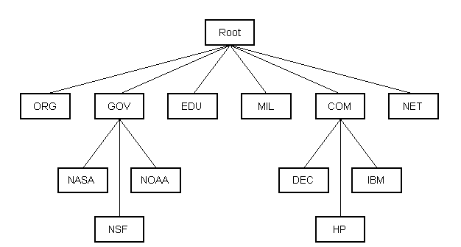
DNS
DNS is structured as a hierarchy similar to the IP routing hierarchy. The computer requesting a name resolution will be re-directed 'up' the hierarchy until a DNS server is found that can resolve the domain name in the request.
http://www.theshulers.com/whitepapers/internet_whitepaper/index.html#http
Notes:
To simplify the DNS process, a series of domains have been created to help logically group sites/addresses.
For example, military sites (in the DoD) will have addresses that end in “.mil” (e.g. lackland.af.mil) Colleges and universities will have addresses that end in “.edu” (e.g. utsa.edu)
This organization makes it easier to find the IP address for a given site. If your system doesn’t already know the address for a site you wish to visit, your system can go up the hierarchy until it finds a system that does know the address. If it gets to the top level in its domain, it can go to the root and be sent to the top level in the domain that your target site is in. This top level in the target domain will be able to use its resources to provide the address you need.
http://www.theshulers.com/whitepapers/internet_whitepaper/index.html#http

Slide 18
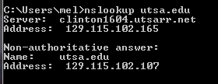
Tools
Nslookup
  Tool used to query DNS for a domain name or IP address
At a command line, type ‘nslookup <hostname>’ and hit enter.

Slide 19
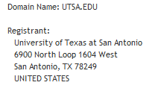
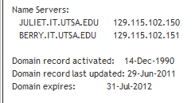
Tools
Whois
  Command returns information about a domain name or IP address such as domain name, registrant, contacts, nameservers, and domain name dates (i.e., activation, expiration)
  To perform a Whois search online go to http://www.internic.net/whois.html
Notes:
To perform a Whois Search: http://www.internic.net/whois.html

Slide 20
Tools
Traceroute
  Command that shows the path a network packet takes from origination to destination
The command displays how many ‘hops’ from router to router it takes for the packet to reach its destination
Also displayed are the addresses of each router and the time it takes for a packet to go from router to router
If a router is not reachable, you will see a request timeout
In UNIX machines the command is ‘traceroute’, in MS Windows machines it is called ‘tracert’.
  This command is not always effective as many sites block ICMP to minimize DDoS issues
The next slide shows an example of running the command
Notes:
To run a traceroute in Windows, enter the word tracert, followed by a space, then the domain name.
C:> tracert www.yahoo.com
Or use a browser and go to http://www.net.princeton.edu/traceroute.html
For more info on traceroute:
http://www.mediacollege.com/internet/troubleshooter/traceroute.html

Slide 21
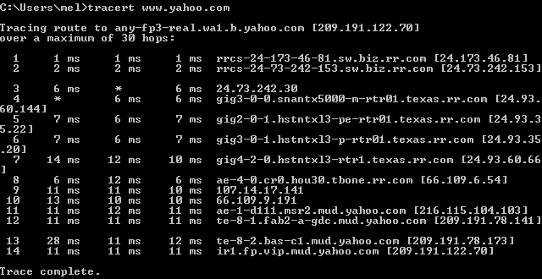
Tools
Traceroute
  See results for ‘tracert www.yahoo.com’
Notes:
To run a traceroute in Windows, enter the word tracert, followed by a space, then the domain name.
C:> tracert www.yahoo.com
Or use a browser and go to http://www.net.princeton.edu/traceroute.html

Slide 22
Tools
Netstat
  A tool for checking network configuration and activity such as
    All connections including what protocol and its current state
    Display contents of the IP Routing table
    Network interface statistics
  Displays different information by using different parameters or ‘flags’ with the command (e.g., ‘netstat –a’)
  Note: Windows and Unix have different ‘flags’ and options available
For Windows XP
  http://www.microsoft.com/resources/documentation/windows/xp/all/proddocs/en-us/netstat.mspx?mfr=true
For Linux
  http://tldp.org/LDP/nag2/x-087-2-iface.netstat.html
  http://www.thegeekstuff.com/2010/03/netstat-command-examples/
Notes:
http://en.wikipedia.org/wiki/Netstat

Slide 23
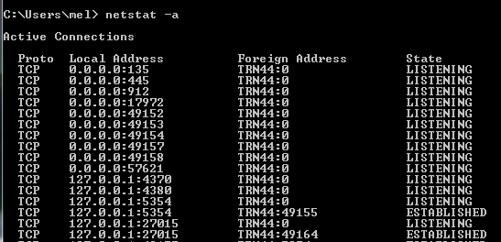
Tools
Netstat
  Display all connections and current state using ‘netstat –a’
  (Windows XP)
Notes:
The above was done by using the ‘netstat –a’ command.

Slide 24
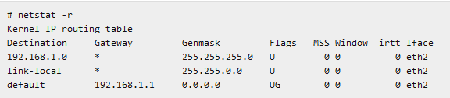
Tools
http://www.thegeekstuff.com/2010/03/netstat-command-examples/
Netstat
  Display contents of the IP Routing table using ‘netstat –r ‘
  (Linux)
Notes:
http://www.thegeekstuff.com/2010/03/netstat-command-examples/

Slide 25
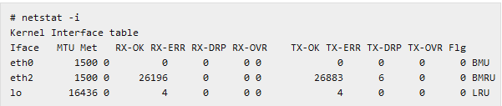
Tools
http://www.thegeekstuff.com/2010/03/netstat-command-examples/
Netstat
  Display interface statistics using ‘netstat –i)
  Linux only
  The RX and TX columns show how many packets have been received or transmitted error-free (RX-OK/TX-OK) or damaged (RX-ERR/TX-ERR); how many were dropped (RX-DRP/TX-DRP); and how many were lost because of an overrun (RX-OVR/TX-OVR)
  The last column shows the flags that have been set for this interface
Notes:
The last column shows the flags that have been set for this interface. These characters are one-character versions of the long flag names that are printed when you display the interface configuration with ifconfig:
B A broadcast address has been set.
L This interface is a loopback device.
M All packets are received (promiscuous mode).
O ARP is turned off for this interface.
P This is a point-to-point connection.
R Interface is running.
U Interface is up.

Slide 26
Tools
Snort
  An open source network intrusion prevention and detection system (IDS/IPS)
  Can be configured in three main modes
    Sniffer
      Will read and display network packets
    Packet logger
      Records packets to disk
    Network intrusion detection
      Monitor and analyze network traffic according to a previously defined ruleset
      Perform defined action based on what it found
  Download at http://www.snort.org/snort-downloads
  The Snort Manual - http://www.snort.org/assets/166/snort_manual.pdf

Slide 27
Tools
Wireshark
  A network packet analyzer that captures packets and displays that packet data for easier examination
  Can be used to
    Troubleshoot network problems
    Examine security problems
    Debug protocol implementations
    Import and export packet data
    Filter packets based on criteria
  Makes it easy to differentiate protocols, traffic, etc. by color coding on screen
  Download at http://www.wireshark.org/download.html
  User guides and presentations at http://www.wireshark.org/docs/

Slide 28
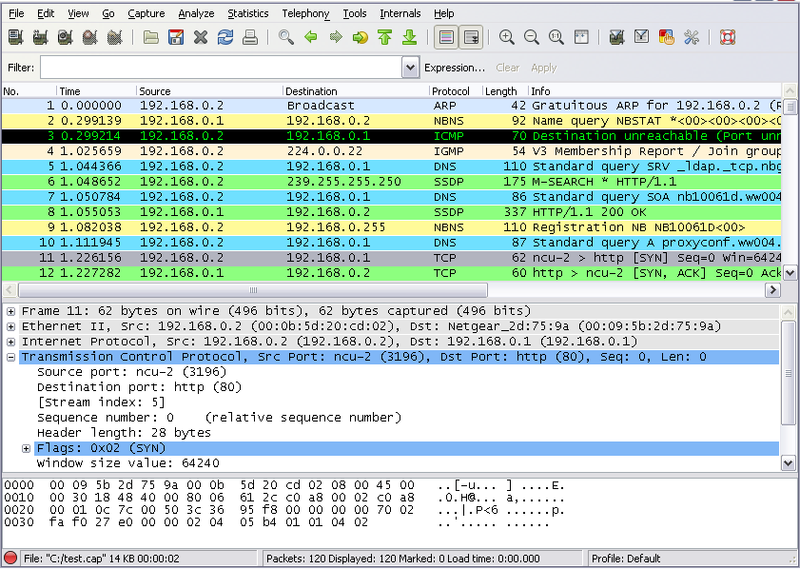
Tools
Screenshot of packets being captured using Wireshark
  For more details, see http://www.wireshark.org/docs/wsug_html_chunked/ChUseMainWindowSection.html

Slide 29
Summary
Identified common network devices
Defined protocols
Discussed the fundamentals of DNS
Introduced some free network configuration tools

Slide 30
List of References
http://www.starlancs.com/EducateMe/educate_network_devices.html
http://www.cisco.com/univercd/cc/td/doc/product/iaabu/centri4/user/scf4ap1.htm
http://www.theshulers.com/whitepapers/internet_whitepaper/index.html#http
http://fcit.usf.edu/network/chap2/chap2.htm
http://www.comptechdoc.org/independent/networking/cert/netterms.html
http://packetlife.net/media/library/23/common-ports.pdf
http://docs.redhat.com/docs/en-US/Red_Hat_Enterprise_Linux/3/html/Security_Guide/ch-ports.html
http://www.mediacollege.com/internet/troubleshooter/traceroute.html
http://www.thegeekstuff.com/2010/03/netstat-command-examples
http://www.wireshark.org/download.html
http://www.wireshark.org/docs/
http://www.snort.org/snort-downloads
http://www.openoffice.org/dev_docs/using_md5sums.html

